Slide 1
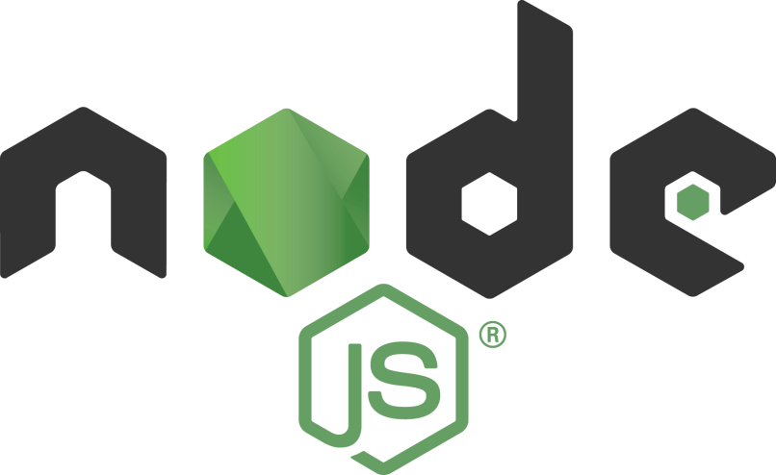
Profiling Node.js Applications
Tamar Twena-Stern

Slide 2
What Is A CPU Profiler
CPU profiler - measure all the CPU ticks spent on executing functions in your application
CPU tick - Arbitrary unit of measure for internal system time.
How many milliseconds a tick represents ? Depends on the OS
Memory Profiler – To detect memory leaks (day 3)

Slide 3
Node.js CPU Profiler – To Find Problems In Node.js Code
The profiler will serve us to find issues in our code
We can understand which function in our code takes long to execute
We can understand how many CPU ticks were spent on each function

Slide 4
In Addition To Code Optimizations – General Performance “Rules”
Always make sure that you are following general performance optimizations :
Optimize DB queries
Make sure you return only what you need
Caching
etc
A lot of times optimizing this will be enough

Slide 5
Node.js Built In profiler
Node.js has a built in profiler
Comes with every Node.js installation
Collects all information to a log file
Generated log file is not human readable
You need a different tool to analyze the profiler log
Fortunately – we have such built in tool as well

Slide 6

How To Run Profiler And Analyzing Tool
To run Node.js program and collect CPU ticks into log file:
Now you have the log file with the ticks execution information.
To Analyze the log file :

Slide 7
Demo – Sync Crypto Performance Bottleneck
crypto module - sync version of pbkdf2
Sync crypto will give big performance hit
Always needed to be replaced with async crypto
Will be easy to find the problem in the output

Slide 8
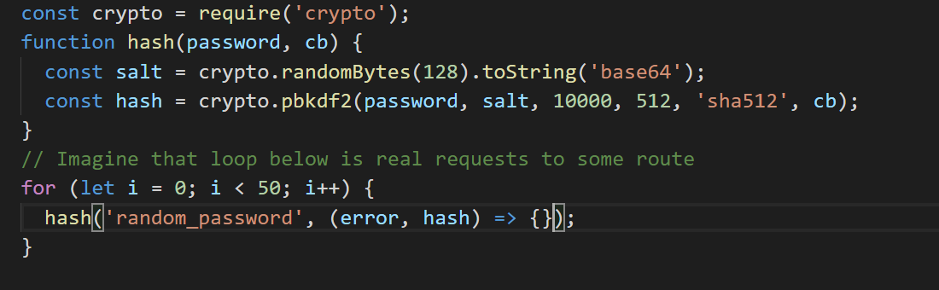
Demo – Sync Crypto Performance Bottleneck

Slide 9
Demo – Run Application With Sync Crypto And See The Problem In The Log File

Slide 10
Performance Analysis Log Sections
Shared Libraries
JavaScript
C++
Summary
C++ Endpoints
Heavy Profiling

Slide 11
Demo Continue – Fix The Performance Problem With Async Crypto

Slide 12
V8 Profiler
Need to be installed by npm module
You are profiling part of your code – a specific function which is suspected
In order to profile you need to change your code :
Import profiler
Explicitly call start profiler in your code
Write profiler Results to a file
Analyze results with node inspector

Slide 13
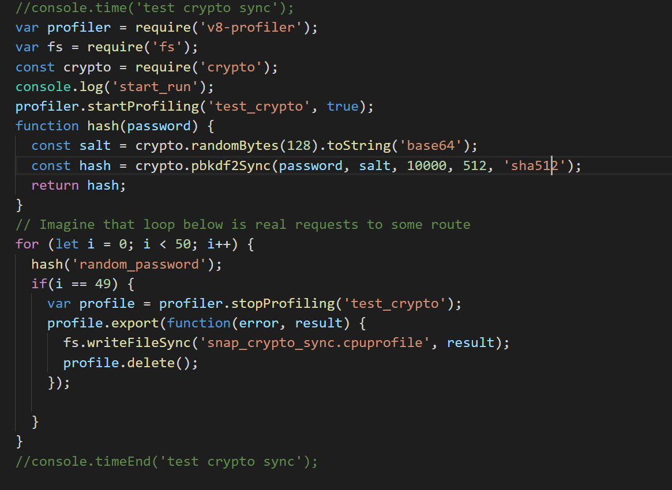
V8-profiler

Slide 14
V8-profiler view .cpuprofile
You can use node-inspector
Best to install it globally
Usually opens on port 8080 on localhost
You can upload file there and see the call tree\
Usually you need to change the suffix of the file to ‘json’ from ‘cpuprofile’

Slide 15
Using Node Inspector To Take Snapshots
Possibility to connect node.js to chrome developer tools
Run your app with –inspect flag
Node –inspect <app_main_script>
Connect to your inspect session with the following url :
chrome-devtools://devtools/bundled/inspector.html?experiments=true&v8only=true&ws=<THE_SOCKET_THAT_YOU_GOT>

Slide 16
Node.js –inspect Example
When running with –inspect I got :
Debugger listening on ws://127.0.0.1:9229/da161d57-bee0-4a2b-a71e-42cb39711875
Use this prefix url in browser to connect:
chrome-devtools://devtools/bundled/inspector.html?experiments=true&v8only=true&ws=127.0.0.1:9229/da161d57-bee0-4a2b-a71e-42cb39711875

Slide 17
Take Snapshot with inspect
Performance tab -> take a snapshot -> take snapshot
You can take a snapshot while sending requests to your server and see what is going on

Slide 18
Questions ?

